Slide 1


Tourism in Europe 1995 - 2019
Contributors:
Haifa Najdawi, Claude Hanfou, Erik Watson, Jay Freeman

Slide 2
Scope of the Project
This project focuses on the impact of tourism in Europe through revenue and number of tourist arrivals from 1995 to 2019.
Our project shall explore the following questions:
Has there been any significant change in tourism revenue & arrivals from 1995-2019?
Is there a noticeable change in tourism arrivals and revenue over a 10 year period(2009-2019)?
Sources: https://data.worldbank.org/indicator/ST.INT.RCPT.CD , https://data.worldbank.org/indicator/ST.INT.ARVL , http://techslides.com/list-of-countries-and-capitals

Slide 3
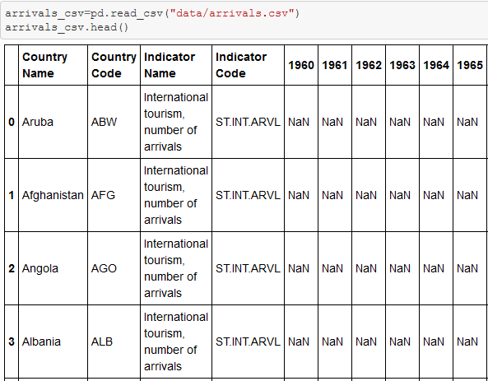
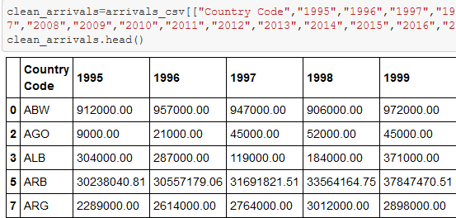

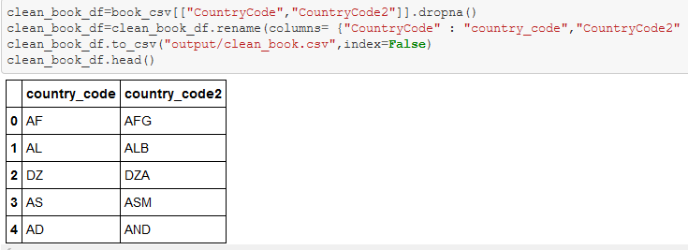
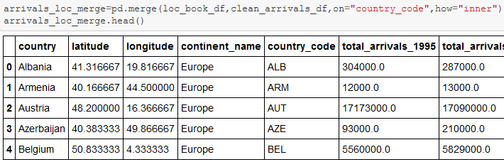
ETL Process
Our data was extracted from World Bank and Techslides.
The data was transformed by filtering the columns to just show European countries, null values were removed, and columns were renamed.
Loaded the data to SQL Postgres.

Slide 4

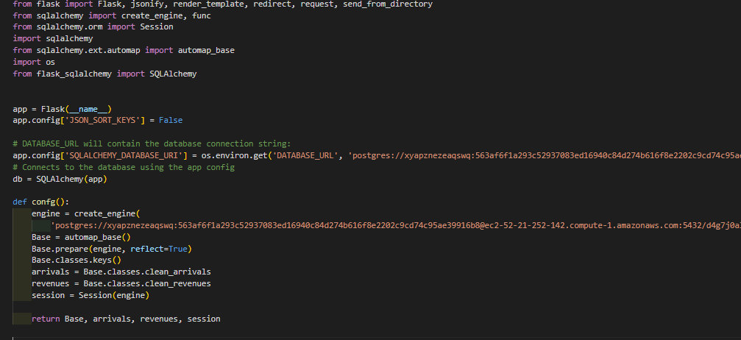
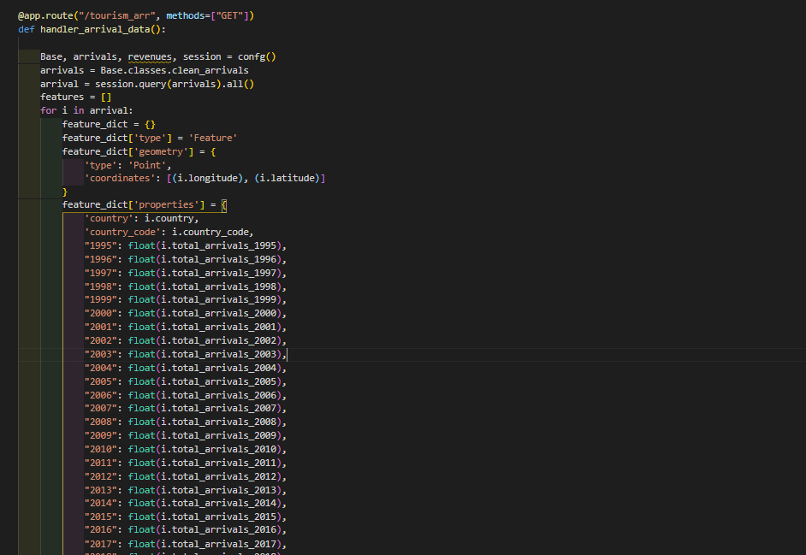
Data Routes Python Flask
We have used flask as a web framework, and we have developed two API’s.
The first query is the arrival data from Postgres and was formatted in json format and is sent back in the response.
The second one does the exact same thing, but for revenues data.
Also, we are using flask to render the html pages and other static files like JS and CSS.

Slide 5

App Deployment Heroku
We used Heroku for hosting our application and database.
For database Heroku provided us with Postgres database and to load the data on this database we took backup from our local Postgres database and restore it on the Heroku’s one.
Also, we have hosted our flask app on Heroku by giving Heroku access to our GitHub repo and required dependances we put it in the requirements file and Heroku took care of all deployment process.
The Heroku app can be viewed at this link: https://europetourism.herokuapp.com/

Slide 6
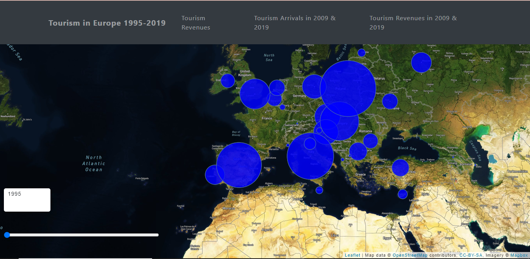
Visualization I Arrivals
A combination of JQuery & Ajax was used to create our maps.
A slider was included on the map to show the changes in arrivals from 1995-2019.
The slider enables the user to make a comparison from a base year 1995 using the circle radius.

Slide 7
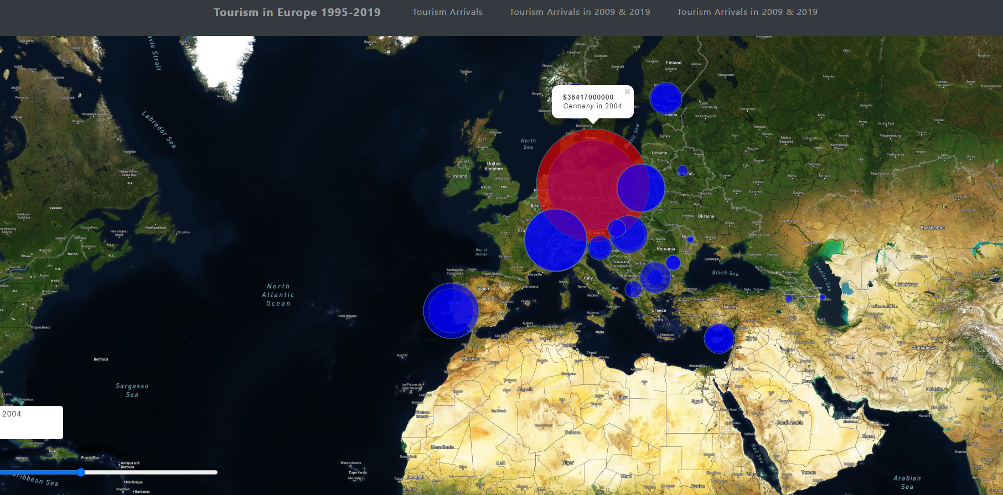
Visualization II Revenues
The circle radius updates to show if there was an increase or decrease in value from the base year.
The map shows the country name, year and value for the specific year.
The tooltip works in combination with the slider to update the value and year for each circle when the slider is moved.
A slider was included on the map to show the changes in revenues from 1995-2019

Slide 8
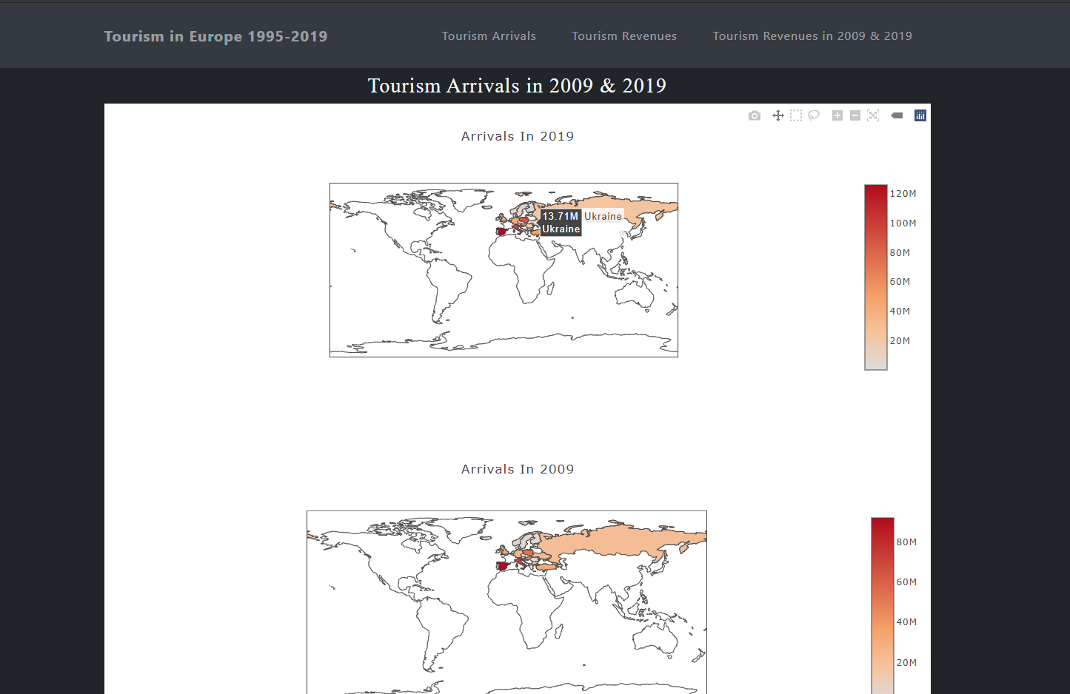
Visualization III Arrivals Last Decade
Plotly was used to create a choropleth map and the comparison was made on tourist arrivals in the last decade The color indicate the changes in each country.
The first map shows the number of tourist arrivals for 2019 and the second map shows the number of tourist arrivals in 2009.

Slide 9
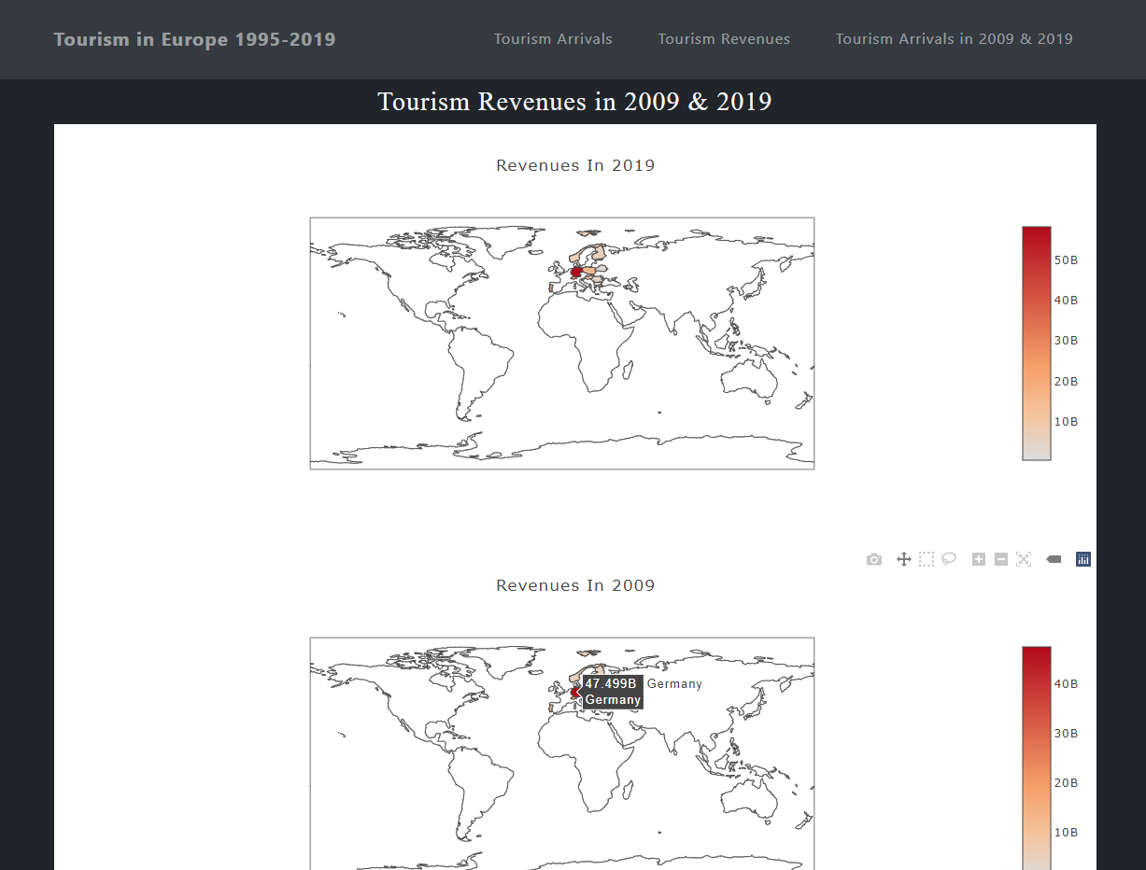
Visualization IV Revenue Last Decade
The first map shows the amount of tourism revenue for 2019 and the second map shows the amount of tourism revenue in 2009.
The marker on the right side of the map is colored coded and the shade goes darker or lighter as the amount of revenues change.

Slide 10
Conclusion
Our conclusion shows that there are is a significant increase in tourist arrivals and amount of revenue. Spain had approximately 52 million tourist arrivals in 1995 and in 2019 that increased to 126 million. In 1995, Germany earned a revenue of 24 billion and then experienced an increase to 58 billion in 2019.

